Slide 1
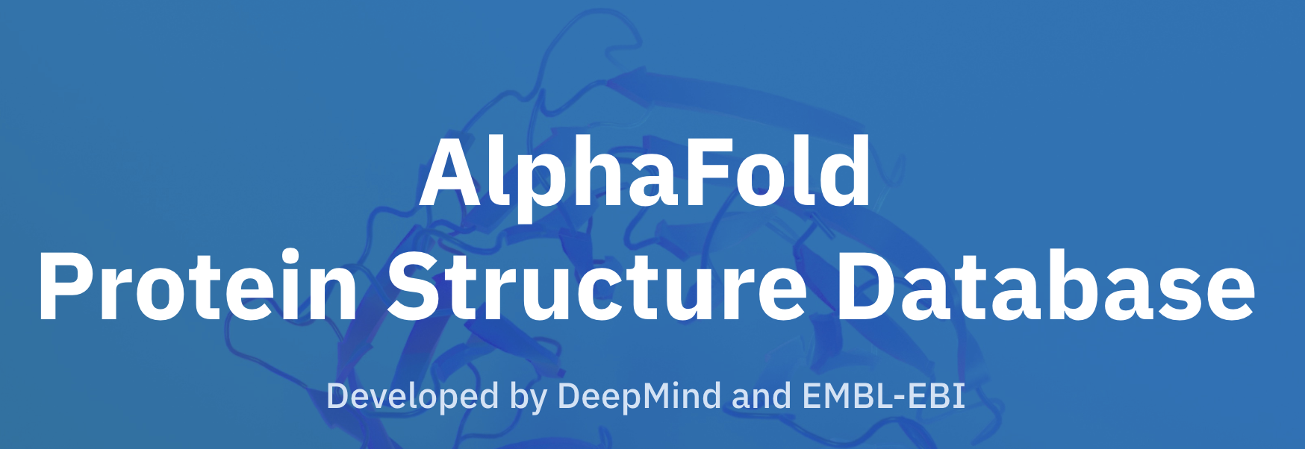

Comparing Jpred and Alphafold
Sophia Constantinou

Slide 2
Overview
Why protein structure prediction is important
Brief overview of how Jpred and Alphafold algorithms work
Steps taken for comparison
Challenges
Statistics computed and scatter plots
Discussion
References and acknowledgments
Notes:
So, a brief overview of what I’m gonna be talking about
First of all, why is predicting protein structure so important?
Then I’m gonna briefly cover how JP and AF work (no ml details bc this is just for background info)
Then I will outline the steps taken to compare the data, cover some of the challenges that I faced
And show some stats and scatter plots
Discussion
And acknowledgements

Slide 3
Why is protein structure prediction important?
Protein structure and folding function
This can be applied in:
Structure-based drug discovery
Protein design
Control/modification of protein function
Experimental techniques (such as crystallography and NMR) are very high cost and require significant time and expertise
Emphasis has been placed on 3D protein prediction using machine learning: neural networks trained on proteins with known structures taken from the Protein Data Bank (PDB) so that they can make ’blind’ predictions.
Notes:
So, Why is protein structure prediction important?
Knowledge of protein structure and folding gives invaluable insight into the function of a protein (find stuff to say)

Slide 4
What does Jpred do?
Given a sequence of amino acids, Jpred predicts secondary structure of proteins: Coil (C), Helix (H) or strand (E) with a confidence score at each residue position
Create 2 profiles which are fed into Jnet (ensemble of neural networks in 2 dimensions)
Training data from SCOPe (filtered):
1507 sequences – divided into training subset (1348 sequences) and blind-test subset (149 sequences)
Typical input*:
Typical output:
MPRLKVKLVKSPIGYPKDQK
CCEEEEEECCCCCCHHHHHH
*Taken from 50S ribosomal protein L30 (truncated)
Notes:
Jpred was developed by the Barton Group to predict secondary structure
It also predicts solvent accessibility and coiled-coil regions
Input can be single aa seq or MSA
C – coil
E – strand
H - helix
It also gives a confidence score at each residue position
The confidence score (0-9) indicates the reliability for each residue and is as important as the prediction
Compares with DSSP to figure out accuracy (8-3 reduced)
Creates 2 profiles (HMM and PSSM) which are fed into Jnet - machine learning algorithm incorporated into Jpred
Training data
Structural classification of proteins (extended) – classifies by domains

Slide 5
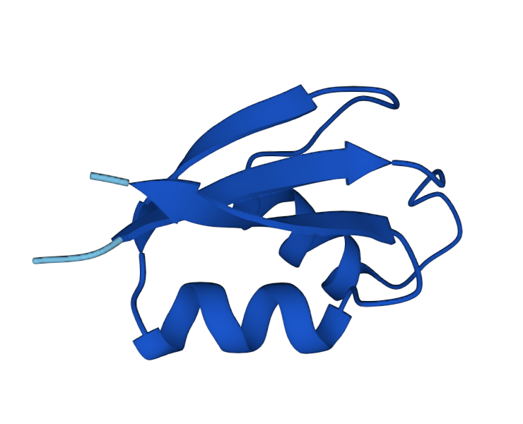
What does Alphafold do?
Typical Input:
Creates a Multiple Sequence Alignment (MSA)
Searches into Uniprot
Identifies important pieces of information in the input and goes back and forth until it has an accurate representation
Uses MSA and pair representation to make a 3D image (list of coordinates)
MPRLKVKLVKSPIGYPKDQK
Typical output:
Source: https://alphafold.ebi.ac.uk/entry/P74909 (Last accessed 15/09/22)
Notes:
Well, what about alphafold?
Alphafold (AF) was developed by Google’s DeepView to predict 3D structure given a sequence of amino acids
In essence, they both take as input an amino acid sequence
However, Alphafold gives a 3d image of the structure – you can see visually helix, strand, coil
The ensemble of neural networks works similarly to Jpred, where it creates a multiple sequence alignment and searches into a database
Alphafold uses a machine learning technique (idea) called attention
Iterative
Pair repre- model of which aa are likely to be in contact with each other

Slide 6
To compare Jpred and Alphafold predictions:
(Using Jpred Training data)
Convert SCOPe ID to PDB ID
1
Convert PDB ID to UniProt ID
2
Search Alphafold using UniProt ID
3
Save Alphafold predictions (pdb files)
4
Run DSSP on Alphafold to obtain secondary structure (reduced) and sequence
5
Align sequences and predictions - SIFTS
6
Notes:
Now that we have all the background information, how can we compare jpred and Alphafold?
Convert Scop to PDB
PDB to Uniprot
Search alphafold website (already given predictions) -- I didn’t run AF
Run dssp – to convert 3d to secondary structure (reduced)
Align the sequences and predictions – using a program called SIFTS
Alphafold searches into the Uniprot database, and thus recognises Uniprot ID’s. To map between SCOPe and Uniprot, they are first converted into the more universal, experimentally-derived PDB ID’s.

Slide 7
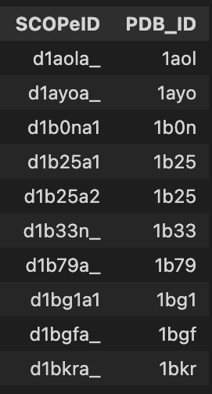
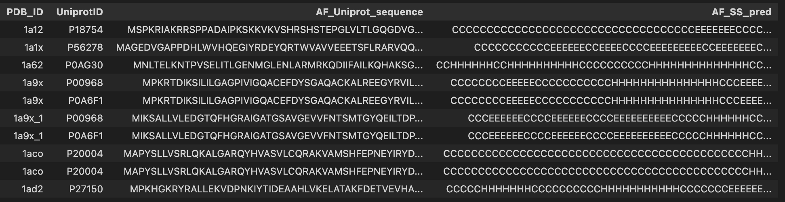
Challenges: Not a 1-1 mapping between databases
1) SCOPe ID → PDB ID
(1348) (1235)
2) PDB ID → Uniprot ID
(1235) (1515)
3) Uniprot ID → AF website
(1498) (1220)
16 PDB ID’s not mapped
291 Uniprot ID’s not found in AF website
883 unique pdb id’s
Chain
Notes:
The first challenge I faced
multiple scope id’s mapped to one pdb
(pdb is 4 characters long and starts from second character)
SCOP is domain, pdb is crystal structure – scop gives chain
Pdb to uniprot –
Running AF – some not found
After running DSSP → 883 unique pdb id’s (1135 Uniprot)

Slide 8
Challenges: Aligning
SCOPe to PDB – need to find start and end point and align
Uniprot and PDB sequences are different
SIFTS – alignment by indexing
1056 sequences – no alignment needed
484 – alignment needed
Notes:
The second challenge that I faced was aligning
Since SCOP shows only domains and PDB is from crystal structure,
Needed to find where the domain started in the crystal structure sequence
Uniprot often larger than PDB, and needs aligning
SIFTS used – show snippet?
SIFTS gives you the position in the uniprot sequence at which the pdb starts

Slide 9
Challenges: Data
Some PDB ID’s were deprecated
Some SCOPe ID’s could not be found (excluded)
Sequences/Predictions not long enough sequences to align
Had trouble getting enough pdb’s to align at first
Notes:
PDB – switched out for the newer versions
SCOP – excluded
Seq/Pred that matched sections sometimes weren’t long enough
So then I’m gonna show you the progression of the aligned data
show progression
Importance of plotting!! – lol

Slide 10
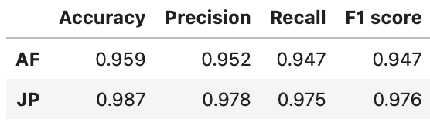
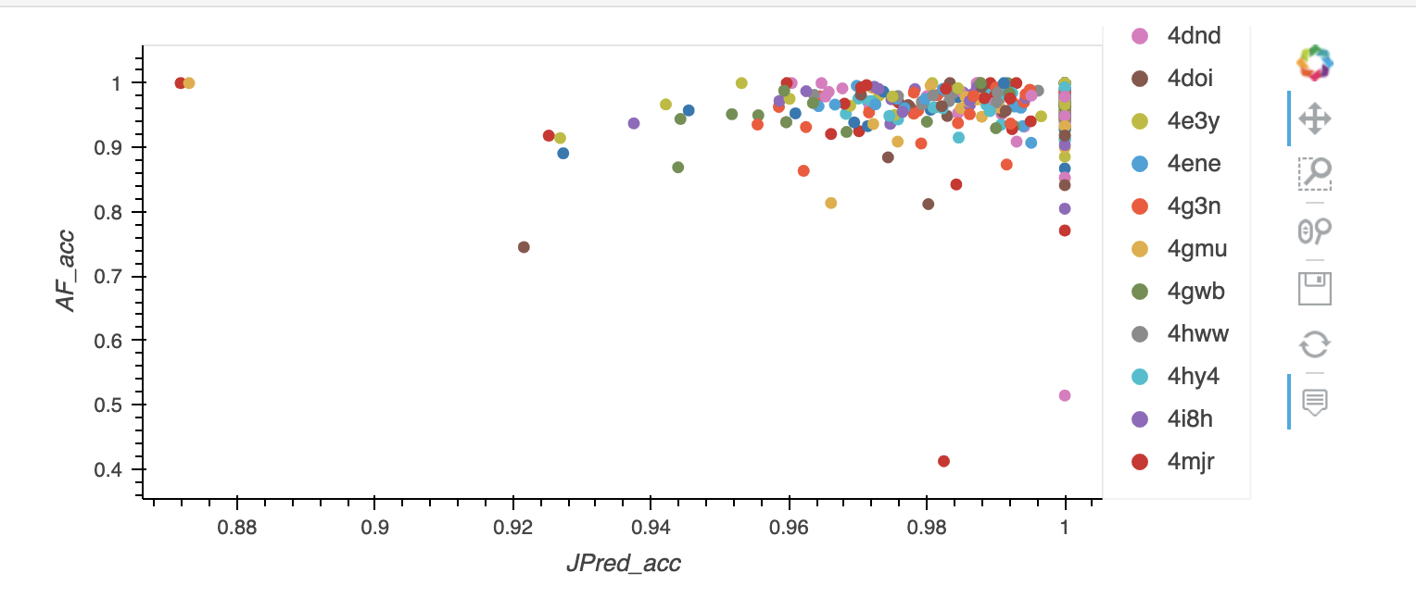
332 pdb id’s
Progression of aligned data
Notes:
Show stuff that’s worth showing – scale, lowest Jpred acc vs lowest AF acc
Talk a bit abt averages
Progression of aligned data –
Accuracy – Proportion of correct predictions
Precision – % of true positive instances out of total predicted positive instances
Recall – % of true positive instances out of total actual positive instances
F1 score – harmonic mean of precision and recall

Slide 11
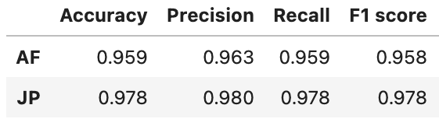
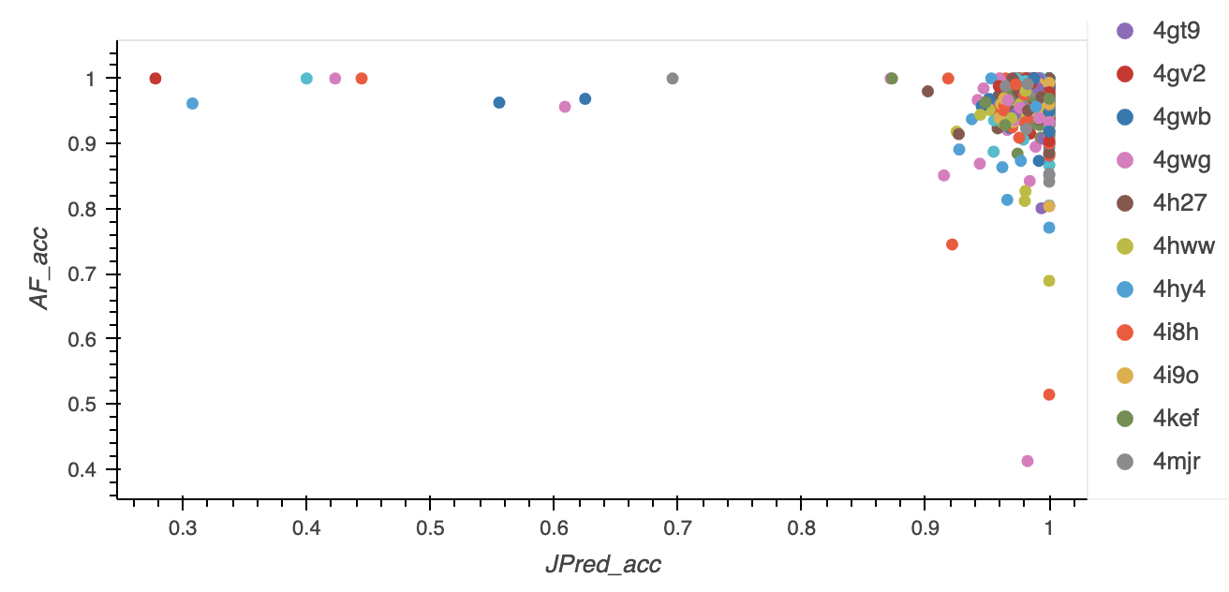
685 pdb id’s
Progression of aligned data
Notes:
Here too
Show stuff that’s worth showing – scale, lowest Jpred acc vs lowest AF acc
Talk a bit abt averages
Progression of aligned data -

Slide 12
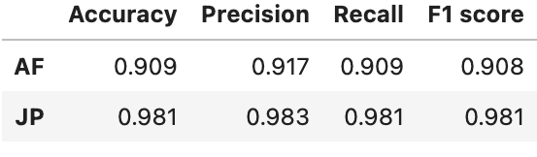
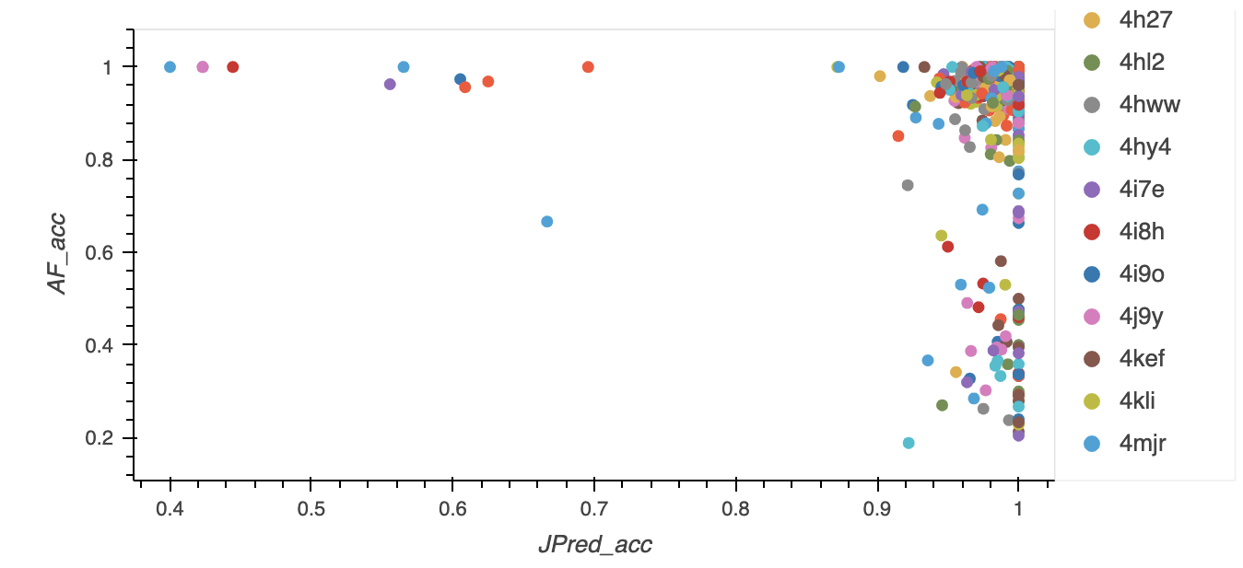
731 pdb id’s
Progression of aligned data
Notes:
Same here
Show bimodality + give intro for colab
Progression of aligned data –

Slide 13
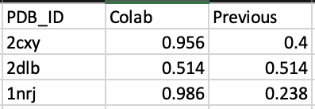
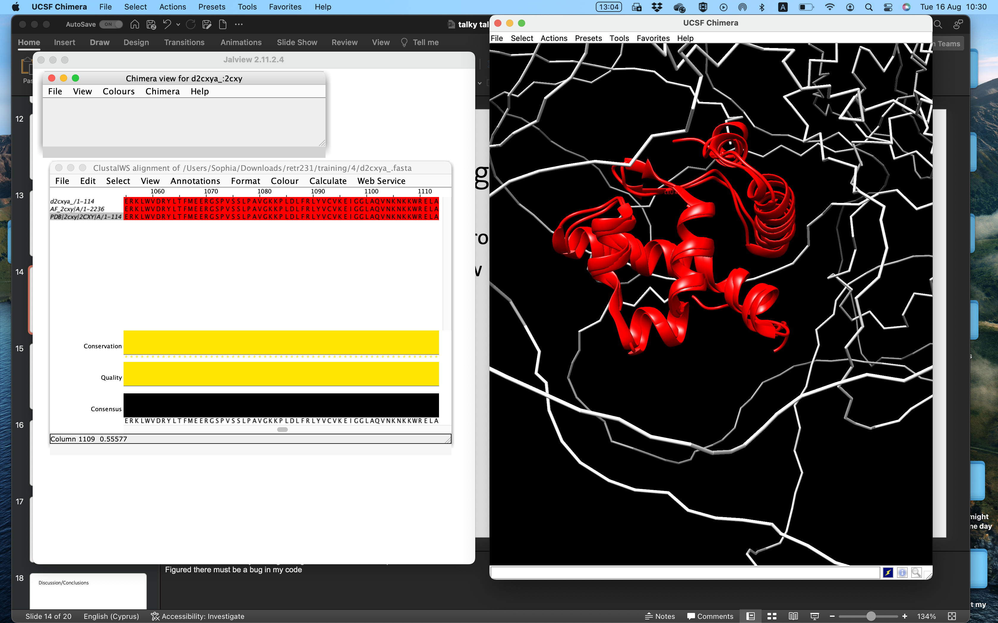
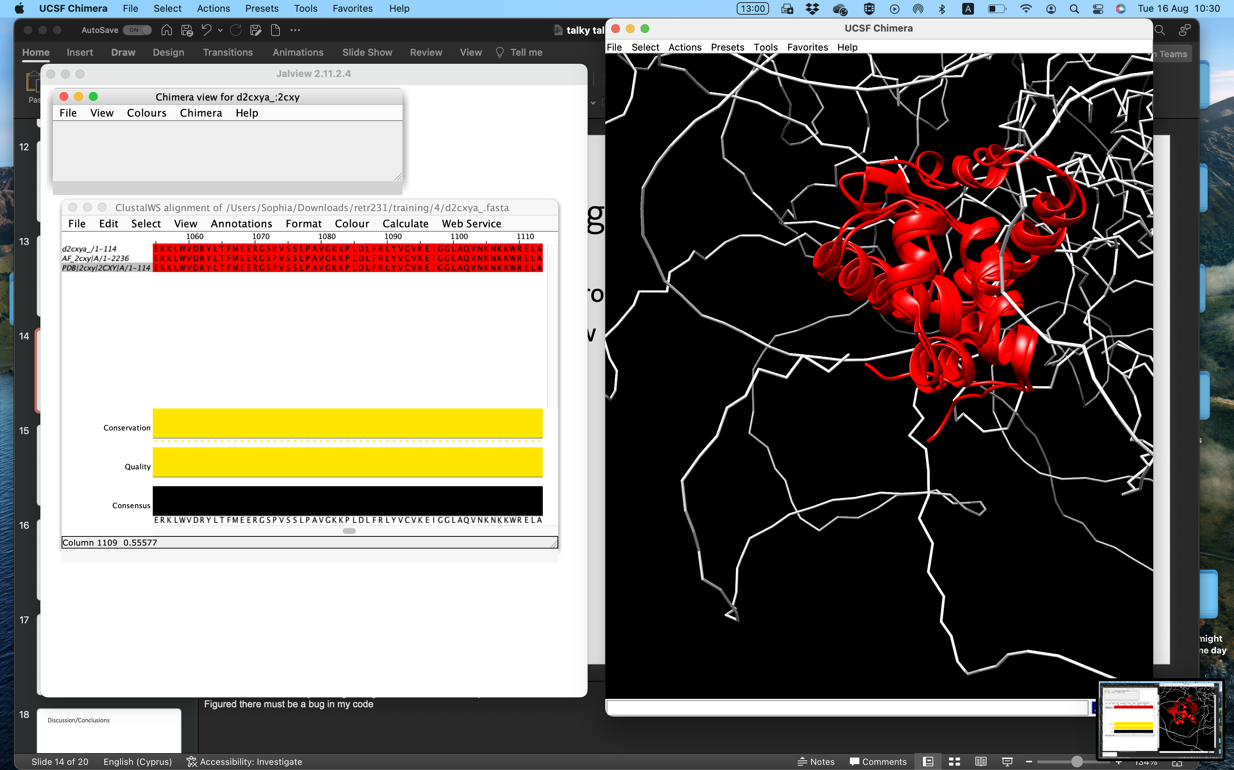
Something wrong..
Bimodality of data
Ran some sequences through colab (AF)
Visualised 2cxy in jalview - chimera
Notes:
Started to check some by running through colab – didn’t match up
Figured there must be a bug in my code

Slide 14
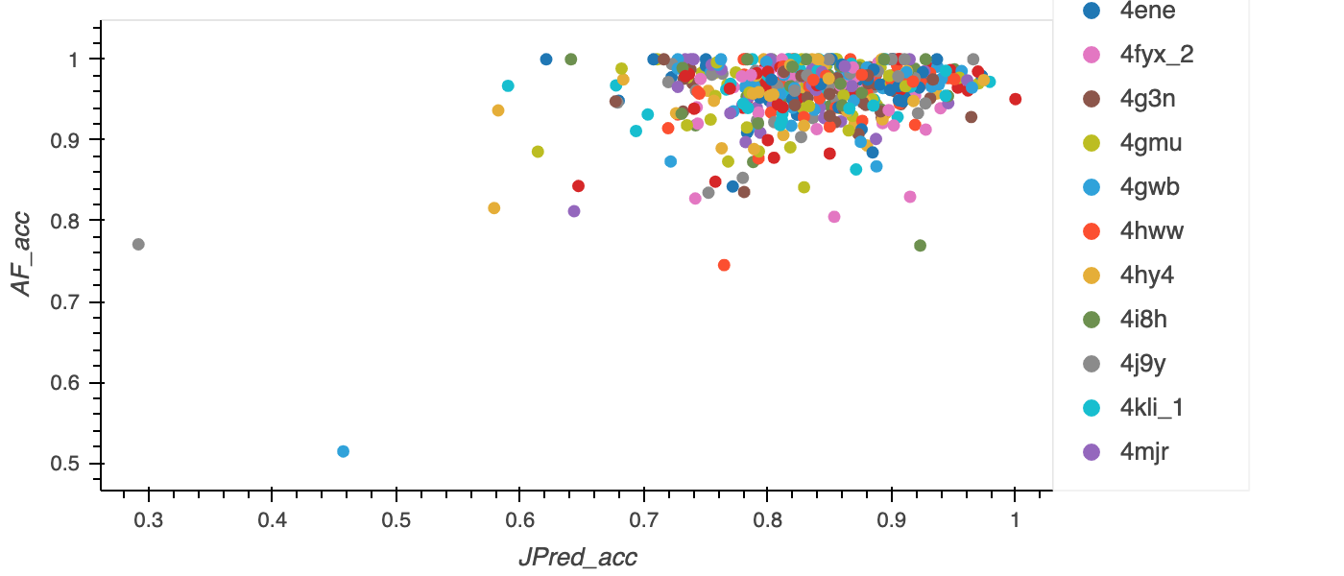
1056 files (no SCOPe alignment)
Exact match: 727
Unique pdb id’s: 511
Notes:
If first 4 residues are the same, (complete matches are 159)
Exact matches 135
Shift scop until it matches the pdb/uniprot sequence
325 not matched
(298 empty and 27 not empty)

Slide 15
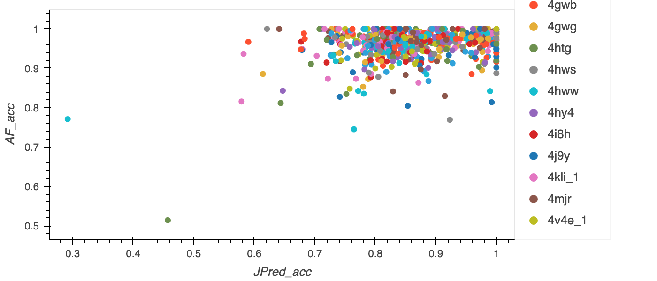
Match first few residues (SCOPe-PDB)
Exact match: 861
Unique pdb id’s: 612
Notes:
If first 4 residues are the same, (complete matches are 159)
Exact matches 135
Shift scop until it matches the pdb/uniprot sequence
325 not matched
(298 empty and 27 not empty)

Slide 16
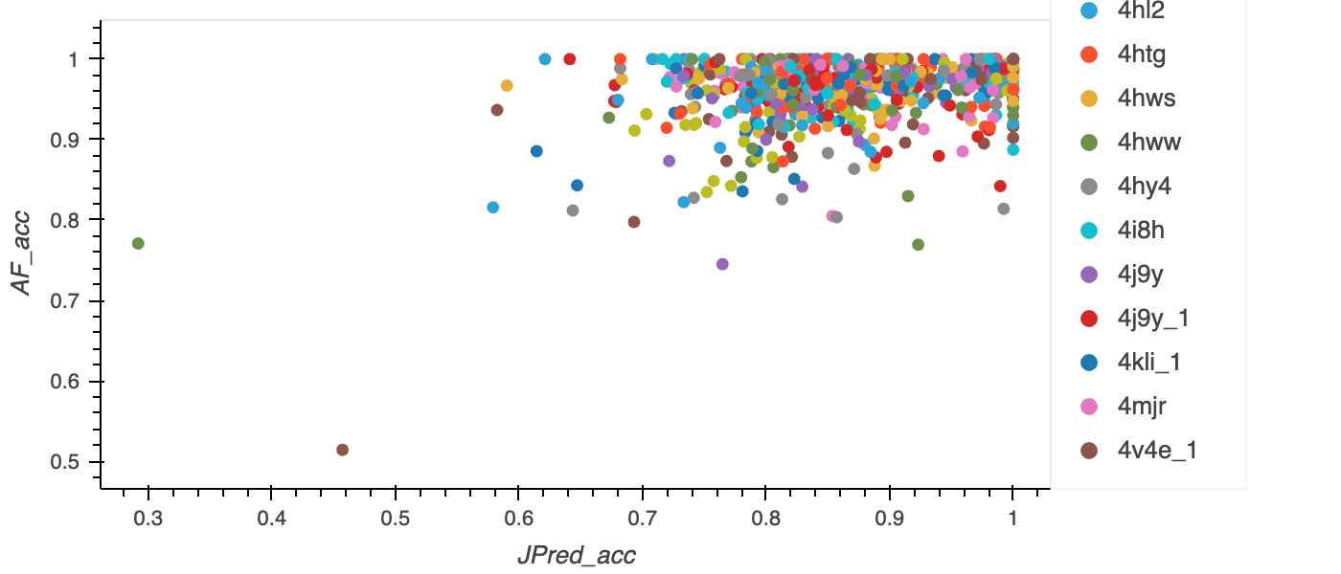
Shift – more SCOPe files aligned
Exact match: 932
Unique pdb id’s: 678
Notes:
H tag etc
Fixes 80 – 218 left unfixed
But match is 71 out of 80
Bfr this
(shift JP until first residue matches) – 80?
First two residues? – try out
Something wrong here – forgot to shift predictions lol
H tag or needed to remove the first few residues

Slide 17
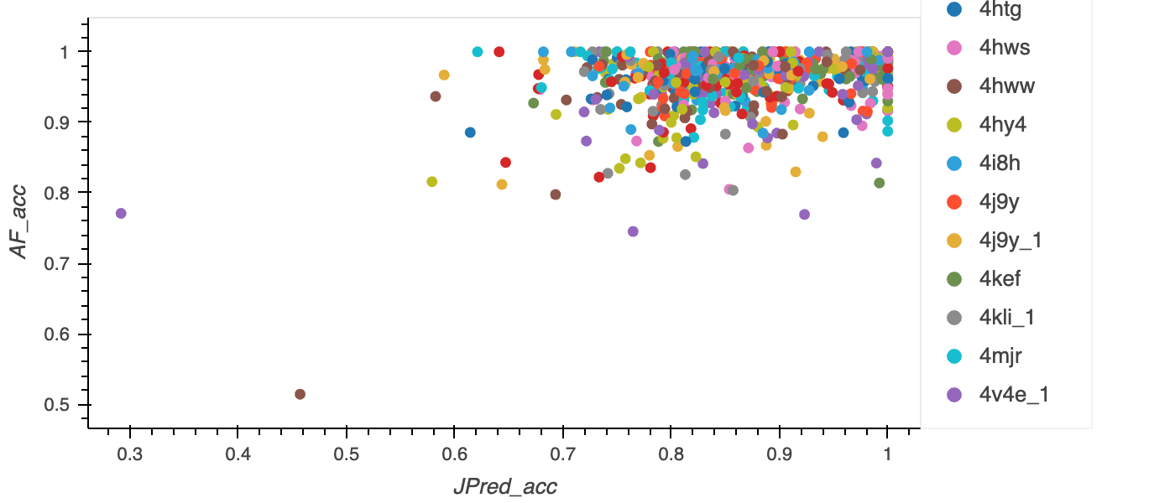
Remove some rows that don’t match
Exact match: 953
Unique pdb id’s: 686
Notes:
21 fixed – 21 matches
Up to 2 rows

Slide 18
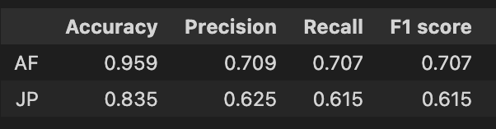
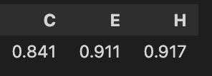
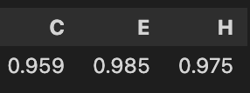
Final stats and plot
JP
AF
2o9u
2dlb
Notes:
AF performs better than JP,
JP has low pred. accuracy in C

Slide 19
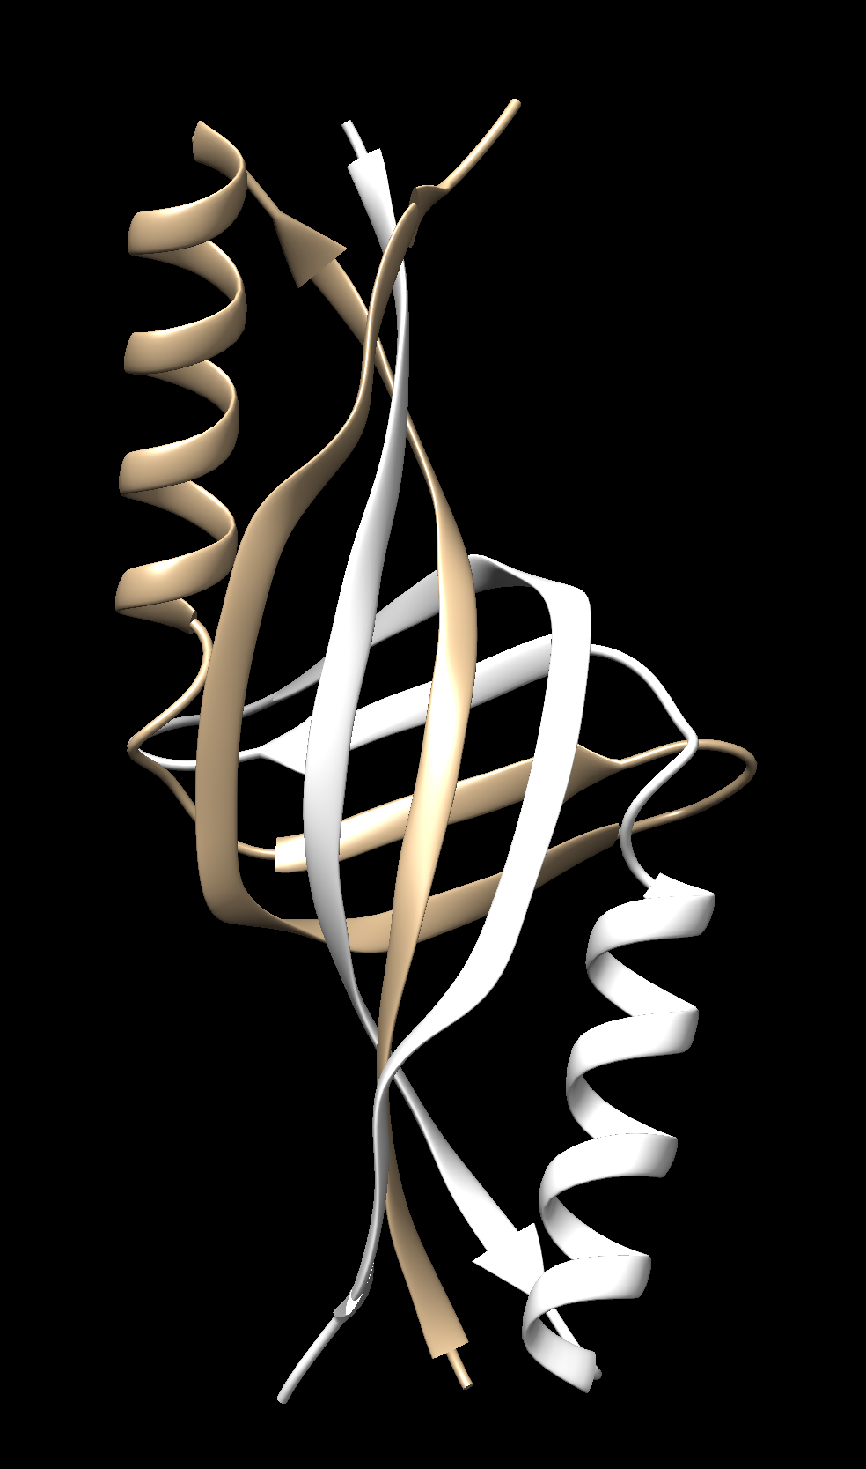
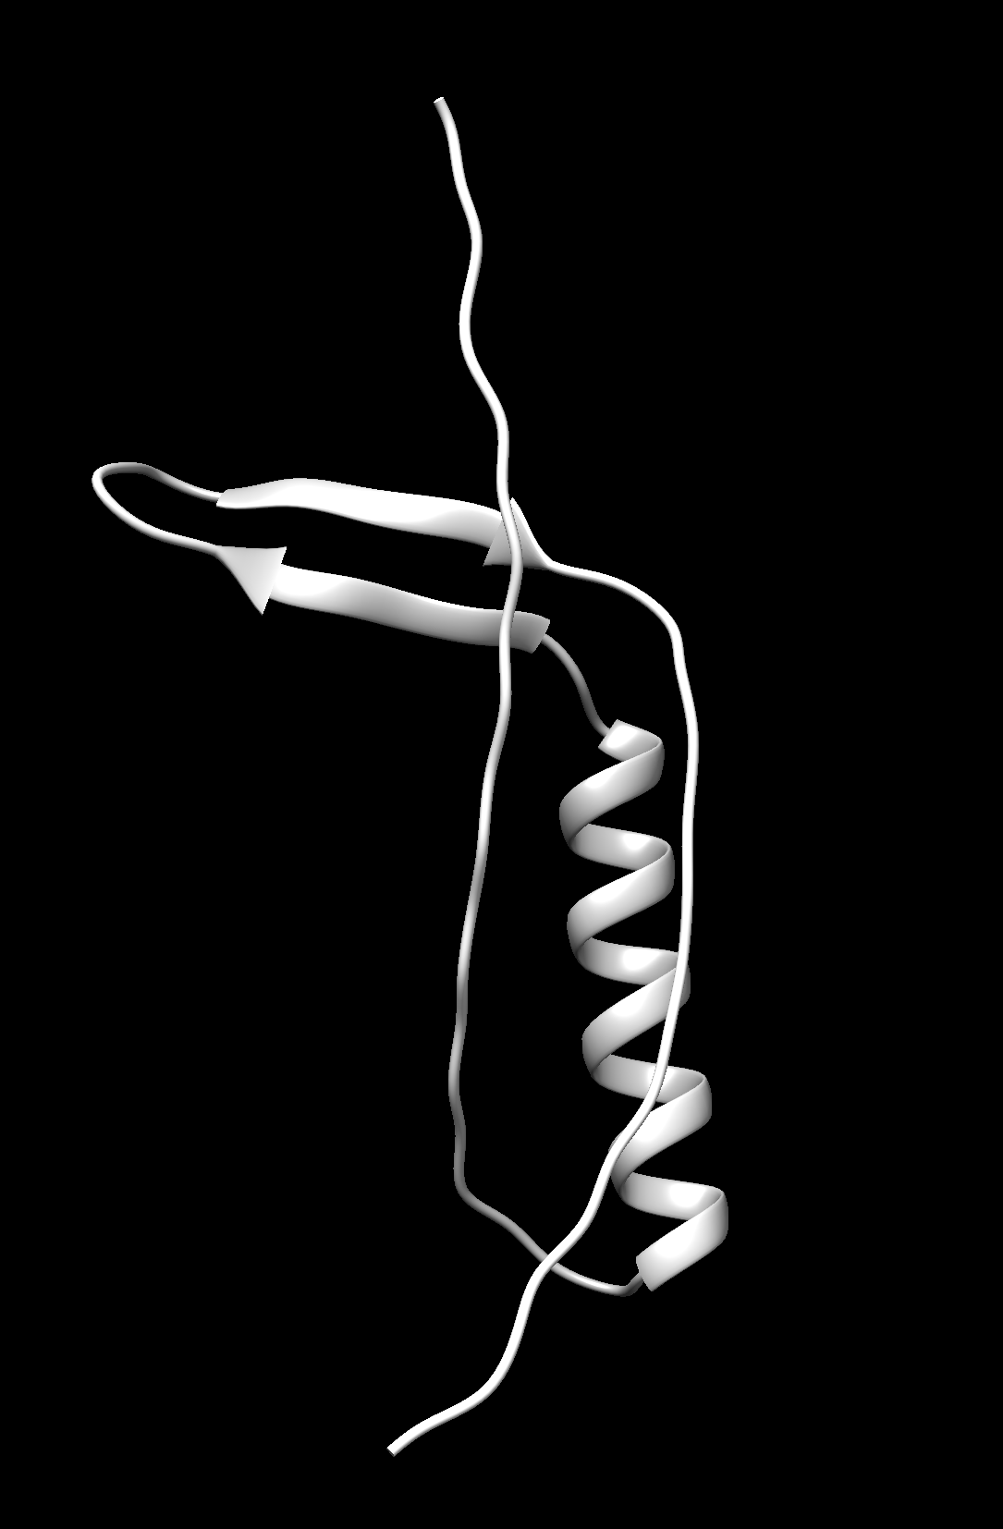
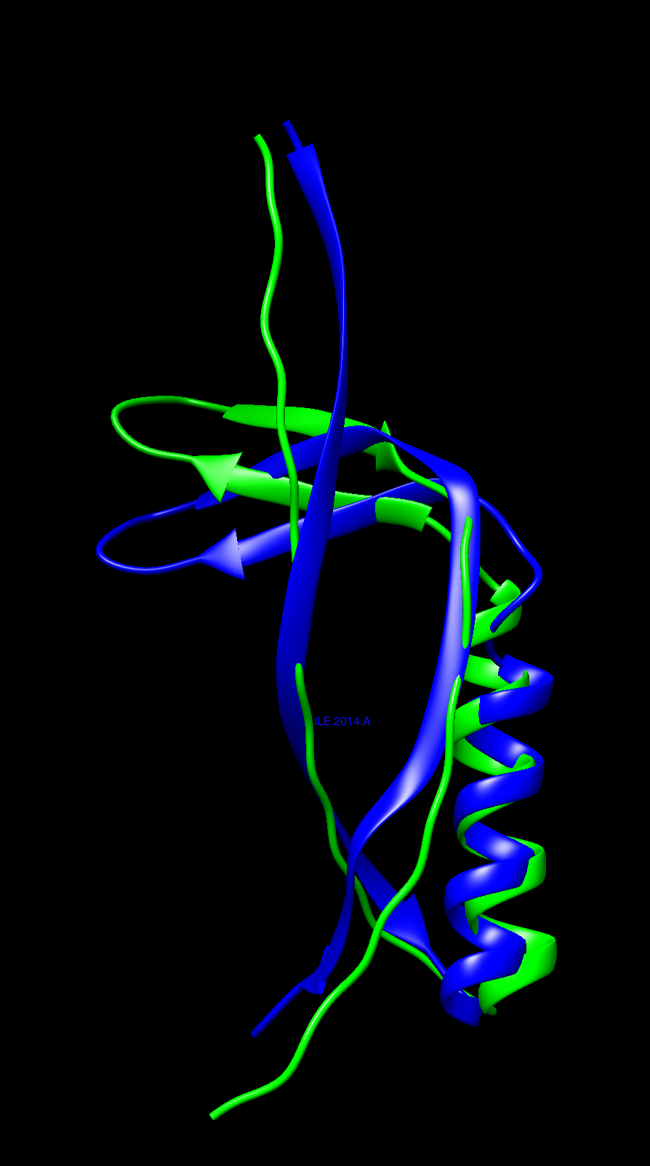
2dlb
Green – AF
Blue - PDB
PDB
AF
Notes:
2 chains
interaction between the 2 chains

Slide 20
2o9u
Data missing from the SIFTS file
Only considers less than half of it – takes parts that it wasn’t particularly effective at predicting

Slide 21
Discussion
Both Alphafold and Jpred have high prediction accuracies
Training data was used (might not be representative) - for further comparison, use 'blind' data
Unmatched files
Notes:
Unmatched/missing files
Jpred – 1348 (unique)
AF - (
of actual prediction accuracies
-Numbers
Stuff that I’ve learnt
/Conclusions??
Not all sequences were matched and compared – try to find missing pdb’s

Slide 22
References
Agnihotry, S., Pathak, R. K., Singh, D. B., Tiwari, A., & Hussain, I. (2022). Protein structure prediction. Bioinformatics, 177–188. https://doi.org/10.1016/b978-0-323-89775-4.00023-7
JPred: A Protein Secondary Structure Prediction Server. (n.d.). Retrieved August 15, 2022, from http://www.compbio.dundee.ac.uk/jpred4/about_RETR_JNetv231_details.shtml
Drozdetskiy A, Cole C, Procter J & Barton GJ. (first published online April 16, 2015) JPred4: a protein secondary structure prediction server, Nucleic Acids Res. Web Server issue
Cuff, J. A. and Barton, G. J. (2000) Application of Enhanced Multiple Sequence Alignment Profiles to Improve Protein Secondary Structure Prediction, PROTEINS: Structure, Function and Genetics 40:502-511
Notes:
Rubiera, C. O. (2021, July 19). Oxford Protein Informatics Group. Retrieved July 7, 2022, from https://www.blopig.com/blog/2021/07/alphafold-2-is-here-whats-behind-the-structure-prediction-miracle/

